Slide 1
Department of Instruction
Budget Work Session
Tuesday, January 22, 2013

Slide 2
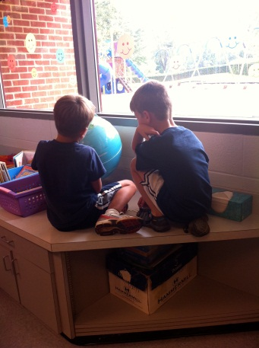

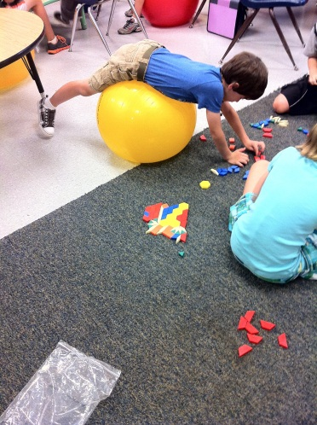
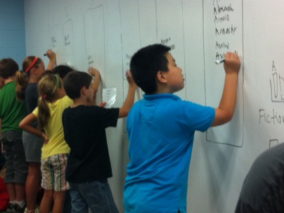
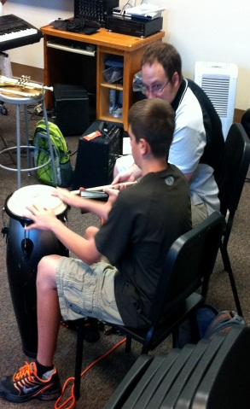
Mission
The Albemarle County Public Schools’ core purpose is to establish a community of learners and learning, through rigor, relevance, and relationships, one student at a time.
Notes:
In the department, we are passionate about our work. We feel that it is our responsibility to bring life to the ACPS mission. First and fore most we see our role is to continually review teaching and learning in the division. We support instruction and assist with the implementation of curriculum and pedagogy. Along with regular instructional support, we also support interventions and preventions for all students: Gifted Services, Special Education, ESOL, AVID, etc. Another part of our job is to inspire innovations. Three years ago, our push for innovation was with CAI and the development of performance assessments. While not completed, that work is on a solid foundation. The new innovation work currently happening is Design 2015.

Slide 3
Work of the Department
AVID
RTI
Performance Assessments
Design 2015
Program Evaluation
M-Cubed
Virtual Courses
Elementary ESOL
Gifted Advisory
Parent Portal Implementation
Responsive Classroom
ST Math
Spelling Bee
New Teacher Academy
Parent Council
AEA Exchange
Teacher Advisory
SEAC
24 Math Competition
Reviewing elementary report card
Notes:
In addition to the direct classroom teaching and assessment work we do in the department of instruction, here are other areas we work with that still affect student learning, but may have more of an indirect manner.

Slide 4
Self-Sustaining Funds
3101 Title 1
3103 Migrant
3115 Adult Education
3116 Econ Dislocated Workers
3142 Alternative Education
3151 Teacher Mentoring Program
3152 Algebra Readiness
3173 Migrant Consort Grant
3201 C.B.I.P. Program
3202 E.D. Program
3203 Title II
3205 Pre-School Special Ed
3207 Carl Perkins Grant
3212 Special Education Jail Program
3215 Title III
3221 El Civics Partnership Project
3300 Community Education
3304 Family In Crisis Grant
3305 Drivers Safety Fund
3306 Open Doors Fund
3310 Summer School Fund
3502 Foundation for Excellence
3909 Textbook Replacement
Notes:
This slide is information only because it has no affect on Superintendent’s budget request. In the budget book, you will find a section that lists self-sustaining funds. Here is a list of self-sustaining funds that are managed by directors in the department of instruction.

Slide 5
Operating Expenses
Funds within the Requested Budget
2100 K-12 Instruction Salaries
2103 Summer School
2111 Instructional Support
2112 Student Services
2113 Federal Programs
2114 Media Services
2116 Vocational Education
2117 Professional Development
2411 Community Engagement
2412 Division Instructional Support
Notes:
For Operating expense, which are part of the Budget request, here is a list of funds that fall under the Department of Instruction. Most of the funds and requests have not changed significantly over the last 2 – 3 years. The largest of these funds is 2111. I will take just a moment to provide some information about this fund.

Slide 6
Fund 2111 – Instructional Support
62111 - INSTRUCTIONAL SUPPORT | 2011/2012 ADOPTED | 2012/2013 ADOPTED | 2013/2014 REQUESTED
 | $1,218,203 | $1,002,947 | $845,150
461211 - GUIDANCE / SCHOOL COUNSELING
461311 - REGULAR ADMINISTRATION
461314 - GIFTED ADMININSTRATION
461317 - COUNTY STUDENT COUNCIL
461318 - VERTICAL TEAMS
461319 - INSTRUCTIONAL COACHING
461330 - INSTRUCTIONAL SYSTEMS - PROJECTS
462420 - FACILITY MAINT. (TELEPHONE SERVICES)
*VIRTUAL SCHOOL BUDGET INITIATIVE (2013-14) |  |  | 181,148
 |  |  | $1,026,298
Notes:
Guidance/School Counseling: Added funds to cover CWRA and Graduation Tracker Information. 2011/2012 – Each department paid for cell coverage versus DART paying the coverages previously. Gifted Administration went up because Governor’s school got charged to schools.
From 2011 – 2012, $103,468 was taken out to reduce the overall school budget. Total reductions were $215,256. Final reduction was $103,468.
Changes from the 2012/2013 budget are a result of transparency. Money that gets transferred out to school – intervention prevention funds, gifted, etc. are now reflected in school based budgets rather than in 2111. Funds that are being used to pay vertical team stipends are now reflected in the HR budget and funds that support student assessments such as the COGAT, PSATs, etc will now be reflected in the Assessment funds as opposed to 2111.
Instructional systems – Projects, supports, mostly stipends. A few examples: paying for substitutes for vertical team meetings, support for Honors Choir, Honors Band and Strings programs, travel for AVID support

Slide 7
Initiatives
Virtual Courses (1 FTE) $248,135
Estimated Expenses
Purchase of Curriculum $95,000
Teacher Professional Development $20,000
Coordinator ( 1 FTE) $67,000
Teacher Curriculum Work $18,000
Teaching Stipends $40,000
Virtual Lab Upgrades $30,000
Notes:
Begining with the students entering the ninth grade in the fall of 2013/2014, every student receiving a standard or advanced diploma will be required to take a virtual course as a graduation requirement. While there are some virtual courses available, through APEX (credit recovery), Virtual Virginia, etc. we will need to develop courses. We will purchase some basic curriculum, but there will be work to do.

Slide 8
Initiatives
Growth Due to Enrollment
(23.64 FTE) $1,483,528
Teacher FTE – 19.64 FTE
Bus Drivers – 4.00 FTE
School Operations - $43,996
Notes:
This initiative stretches across several departments. The three areas of growth identified in this initiative are teacher FTE, Bus Driver FTE, and school operational budgets – which is simple a result of increased student enrollment. I will address the growth for teacher FTE.

Slide 9
Initiatives
Growth Due to Enrollment
(23.64 FTE) $1,483,528
2012/2013 Class Sizes
Grade Band | Mean Class Size | ACPS Standards | ACPS Differentiated
K – 3 | 18.73 | 20.25 | 11.90 to 1 F/R
4 – 5 | 20.20 | 22.65 | 11.90 to 1 F/R
6 – 8 | 21.61 | 23.37 | 10.35 to 50% F/R
9 – 12 Core Classes | 20.16 | 24.20 | 10.30 to 50% F/R
9 – 12 CTE and FA | 19.87

Slide 10
Initiatives
Growth Due to Enrollment
(23.64 FTE) $1,483,528
2012/2013 High School Teacher Loads
School | 130 – 135 | 136 – 140 | Greater than 140
Albemarle (86) | 7 | 3 | 1
Monticello (60) | 5 | 2 | 6
Western Albemarle (61) | 12 | 2 | 4
Grade Band | Mean Class Size | ACPS Standards | ACPS Differentiated
9 – 12 Core Classes | 20.16 | 24.20 | 10.30 to 50% F/R
9 – 12 CTE and FA | 19.87

Slide 11
Initiatives
Elementary Staffing Standards
(3.83 FTE) $163,236
Modify staffing standards for large elementary schools: OA Clerical, Media Clerical, Guidance, and PE
Position | Current | Proposed
OA Clerical | 1 12-month OA IV & 1.5 10-month OA III at 500 | 1 12-month OA IV, 1 12-month OA III & 1 10-month OA III at 600
Media Clerical | None | 0.5 10-month OA II at 600
Guidance | 1.5 FTE at 575 | 2.0 FTE at 625
Physical Education | 3.3 FTE at 660 to 719 | 3.6 FTE at 660 to 719
Notes:
Elementary schools with projected enrollments over 600 for next year are: Agnor-Hurt 610, Brownsville 722, and Cale 617. Last year we adjusted music and art staffing standards.

Slide 12
Initiatives
Staffing Standards
(2.1 FTE) $140, 673
Modify Elementary and Middle School Assistant Principal Staffing Standards
Position | Current | Proposed
Elementary School Assistant Principal | 1 Assistant Principal at 400 based on a two-year average | Add 1 10-month Assistant Principal at 700
Middle School Assistant Principal | 1 Assistant Principal at 400 based on a two-year average | Add 1 10-month Assistant Principal at 700
Notes:
This initiative would apply to Brownsville and Henley. Brownsville’s projected enrollment for 2013/2014 is 722 and Henley’s projected enrollment for 2013/2014 is 812.

Slide 13
Initiatives
Special Education Staffing (2.5 FTE) $167,467
Special Education Teachers
Total points / by 20 = FTE required by VADOE
Self-contained classes = 1 Teacher, 2 TAs to 8 Children
IEP Services | Points
1 – 49% | 1
50 – 100% | 2.5
50 – 100% Autism or Multiple Disabilities | 3.3
Notes:
Special Education Teachers are staffed by State Regulations. Points are assigned based on level of individual need. Student need is calculated as a percent of the instructional day. The number of FTEs is determined by taking the total number of points and dividing by 20, these are VADOE guidelines.

Slide 14
Initiatives
Special Education Staffing
Special Education Teaching Assistants
  Self-contained classes = 1 Teacher, 2 TAs to 8 Children
Level | Staffing
High School | 3
Middle School | 1
Elementary | Based on student need or IEP

Slide 15
Initiatives
Special Education Staffing
Psychologists
  Elementary
    .4 FTE minimum support
    FTE at approx. 10% of student population
  Middle School
    FTE at approx. 10% of student population
  Other Assignments Based on Experience
    High Schools (1.4 FTE)
      Utilize Social Workers and Psychologist Hybrid
    Private School Evaluation (.3 FTE)
    Preschool Evaluation (.5 FTE)

Slide 16
Initiatives
Special Education Staffing
Speech Pathologists
  Caseload Target of 50
  Division broken up into “Zones”
  Caseloads at each school x 10% = FTE
  Zones staffed to cover the projected caseloads
Occupational Therapists
  Caseload Targets of 40-50
Physical Therapists
  Caseload Targets of 40-50

Slide 17

Initiatives
Increase ESOL Staffing (1 FTE) $66,987
ESOL Program Mission
To prepare emergent bilingual students to succeed civically, socially, and economically in a global community.

Slide 18
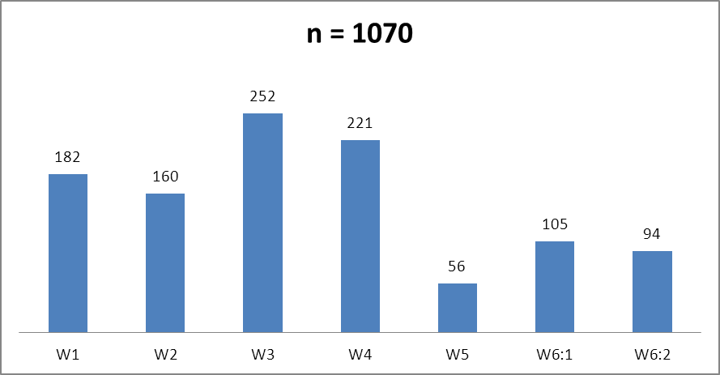
ACPS ESOL Students by Level
January, 2013

Slide 19
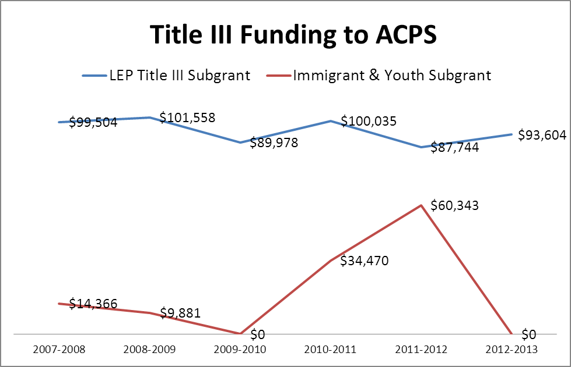
Federal Funding
TITLE III 2012-2013
Instructional Liaisons
.4 FTE
ESOL Coaching
.3 FTE
Data Administration
.3 FTE
ESOL Family Liaison
.5 FTE
Tutoring
$5,000
Notes:
The immigrant & youth subgrant is awarded to divisions that have experienced a significant increase in the enrollment of students born outside of the United States compared to average enrollment of these students over the last two years. Determination is made based on the prior year’s enrollment, e.g. Fall, 2012 grants were based on enrollment figures in Fall, 2011.

Slide 20
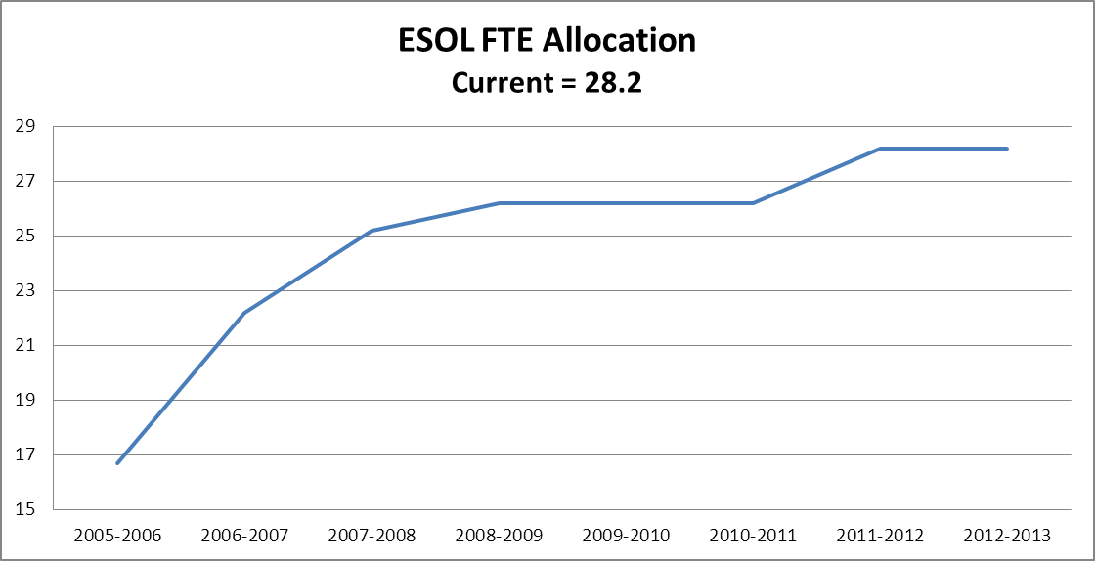
ESOL Staffing Allocation & Distribution
ESOL STAFFING RATIOS
ELP Level | K-5
W1 | 1:25
W2 | 1:40
W3 | 1:60
W4 | 1:60
W5 | 1:80
W6:1 | 1:80
W6:2
ELP Level | 6-12
W1 | 1:25
W2 | 1:40
W3 | 1:60
W4 | 1:60
W5 | 1:80
W6:1 | 1:80
W6:2

Slide 21
Initiatives
Piedmont Regional Education Program (PREP)
$258,942
Maintenance of Effort
Increase to provide services to students at Ivy Creek
Related services: Parent Resource Center, Vision
Regional Reimbursement

Slide 22
Initiatives
Response to Intervention
(2.8 FTE) $187,564
Requested 5.8 FTE for the 2012/2013 Budget: 3.0 FTE was funded
Restore the remaining 2.8
Initiative provides interventions to students

Slide 23
Initiatives
Community Public Charter School
1.85 FTE $123,925
CPCS opened in 2007 with volunteer administrative staffing and teacher staffing supported through fund raising
Currently staffed at same levels as other middle schools in ACPS
Requesting 1.85 FTE which would provide teacher and administrative support

Slide 24
Sequestration
Grant | 10% Grant | 10% Personnel | Approximately FTE
Title I | $131,993 | $119,522
Title I, Pt C (Migrant) | $10,208 | $8,269
Title II | $33,418 | $28,510
Title III | $9,360 | $9,360
Total | $184,979 | $165,662 | 2.47
IDEA (Total) | $283,322 | $283,322 | 4.23

Slide 25
Questions?
Department of Instruction Directors
Assistant Superintendent: Billy Haun
Executive Director K – 12: Debbie Collins
Executive Director of Community Engagement: Bernard Hairston
Director of Special Education: Kevin Kirst
Assistant Director of Instructional Programs: Chad Ratliff
Assistant Director of Instruction – Intervention/Prevention Services: Betsy Agee
Director of Professional Development: Becky Fisher

